Slide 1
Room Booking System and Price Prediction.
Prathamesh Kulkarni
Associate Software Engineer
Data Lake

Slide 2
About the project
Single interface application for room adding and booking.
Functionalities:
Add Rooms
View Rooms
Book Rooms
Predict Room Prices(Independent module)

Slide 3
Goal
To build a Room Booking System with fundamental python concepts.
Concepts Used : Python Fundamentals, OOPs concepts, error handling.
Framework: Flask
Data reading and manipulation : Pandas and Numpy.

Slide 4
Modules in the Project
Dataset Creator – Creates dataset using numpy for price prediction.
EDA- Analysis.py shows the analysis of data which shows trends and price distributions with various attributes
Model – Model.py is the module used to create a pickle file of data trained using linear regression model.
Flask application – app.py contains the logic to the working web application and prediction module.
Templates – contains HTML files which are displayed on the frontend
Static – CSS styling pages.

Slide 5
Data for Prediction
Created a dataset based on the attributes choosen.
Used numpy and pandas to create dataset.
Attributes used: Room Type(4), Sea Facing(3), Jacuzzi(Bool), Balcony(Bool), Bed Type(3), In-Room Technology(2) ,Season(2) ,Floor Level(integer), Price

Slide 6
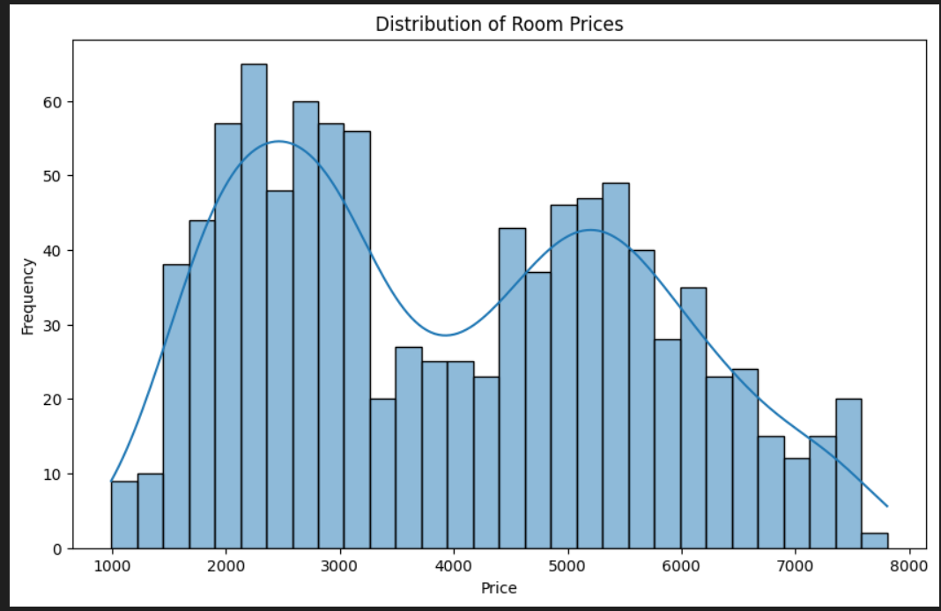
Exploratory Data Analysis
Distribution of Room prices

Slide 7
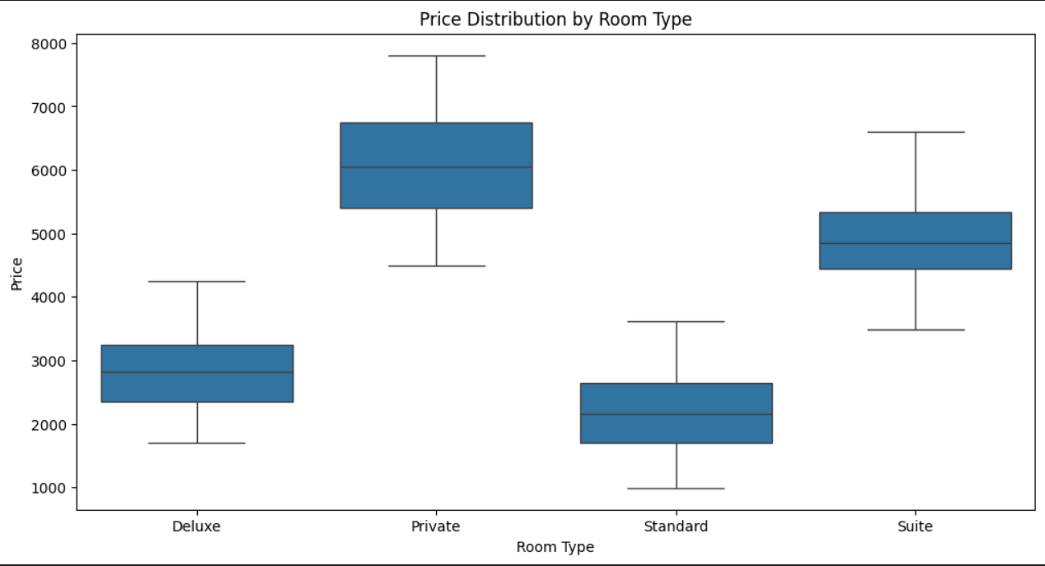
Price distribution by room type

Slide 8
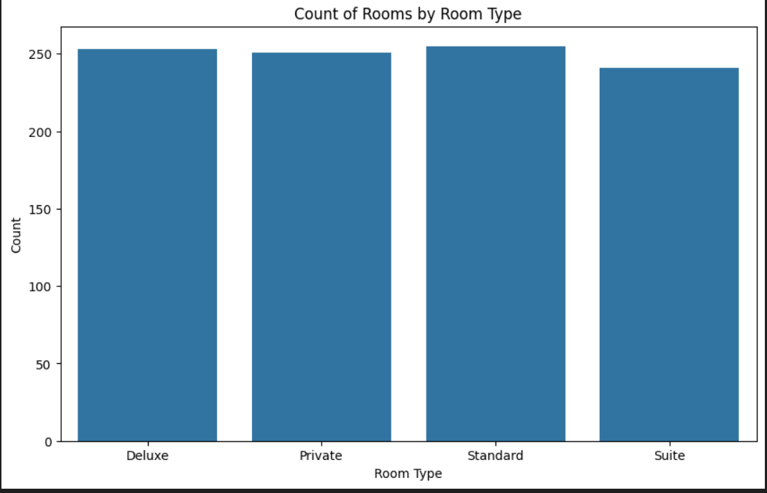
Count of Room Types

